Slide 1





مبادرة رواد مصر الرقمية
Round 2
Odoo Application Consultant
Next Academy
Group: NXT1_GIZ2_ERP1_G1
Team No. 4
Nesma Hamed
Basem Adel
Tahya Mohamed
Ahmed Snousy

Slide 2


Odoo ERP Implementation for STARS STEEL Prepared by Z company April 2025

Slide 3
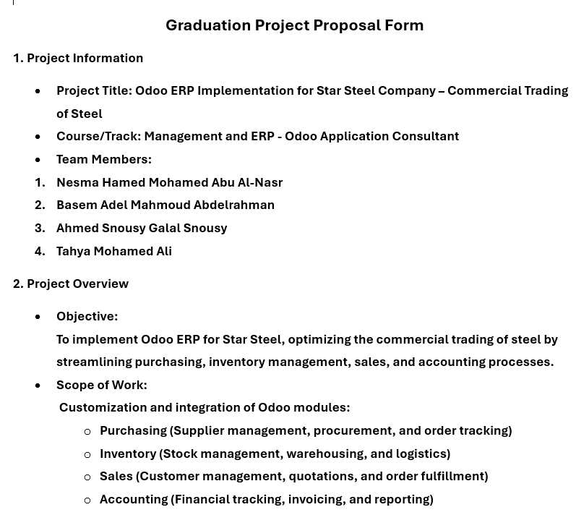
proposal

Slide 4
Company Overview
Company Name: Star Steel Trading Co.
Industry: Steel Reinforcement Trading
Year Established: 2000
Headquarters : Cairo, Egypt
Scope of Work :
Supplying high-quality steel reinforcement products
Serving construction companies and mega projects
Business Size :
Annual Turnover: 150 Million EGP
Workforce: 35 employees
Vision :
To be the leading supplier of reinforcement steel solutions in Egypt and the Middle East.
Mission:
Deliver premium quality products with exceptional service.
Build sustainable relationships with clients based on trust and excellence.
Contribute to the development of modern construction infrastructure.

Slide 5
Current Situation:
The company currently relies on manual processes and disconnected software systems.
Sales and purchase tracking is slow and prone to errors.
Financial and inventory reporting is delayed and lacks accuracy.
Departments operate independently with minimal integration.
Stock management is mostly manual, leading to inefficiencies.

Slide 6
Identified Gap
Lack of system integration across departments.
Delayed access to real-time business data.
High risk of manual errors affecting operations.
Inefficient inventory control and tracking.
Difficulty in scaling operations without a centralized syst

Slide 7
Project Initiation Documents
1. Kick-off Mail
Official email to confirm understanding of the identified gaps.
Introduces the project team and defines the preliminary project scope.
Schedules initial project meetings with client stakeholders.
Serves as the first formal communication between both parties.
2. Blueprint Document
Created after kick-off meetings and workshops with the client.
Documents current business processes and the identified gaps in detail.
Defines the future system design and solution approach.
Requires client approval before moving to development/configuration phase.
3. Contract/Agreement
Signed once the Blueprint is finalized and approved.
Clearly outlines project deliverables, timeline, payment terms, and responsibilities.
Provides the legal framework for the project execution.

Slide 8
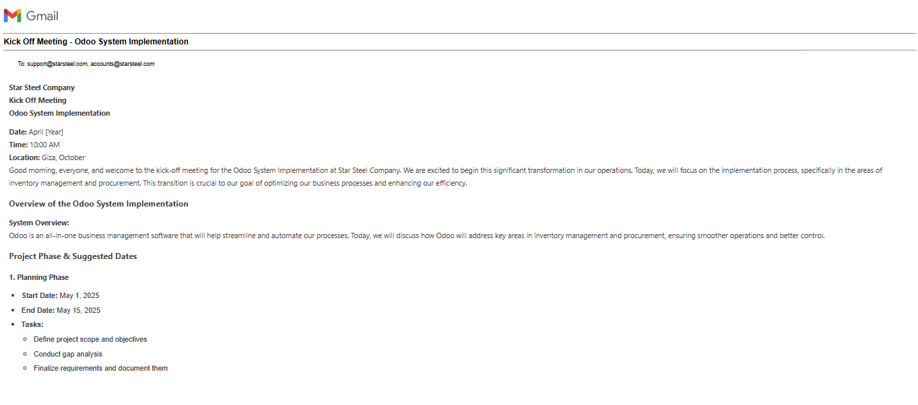
Project Kickoff: Aligning with Star Steel by mail

Slide 9
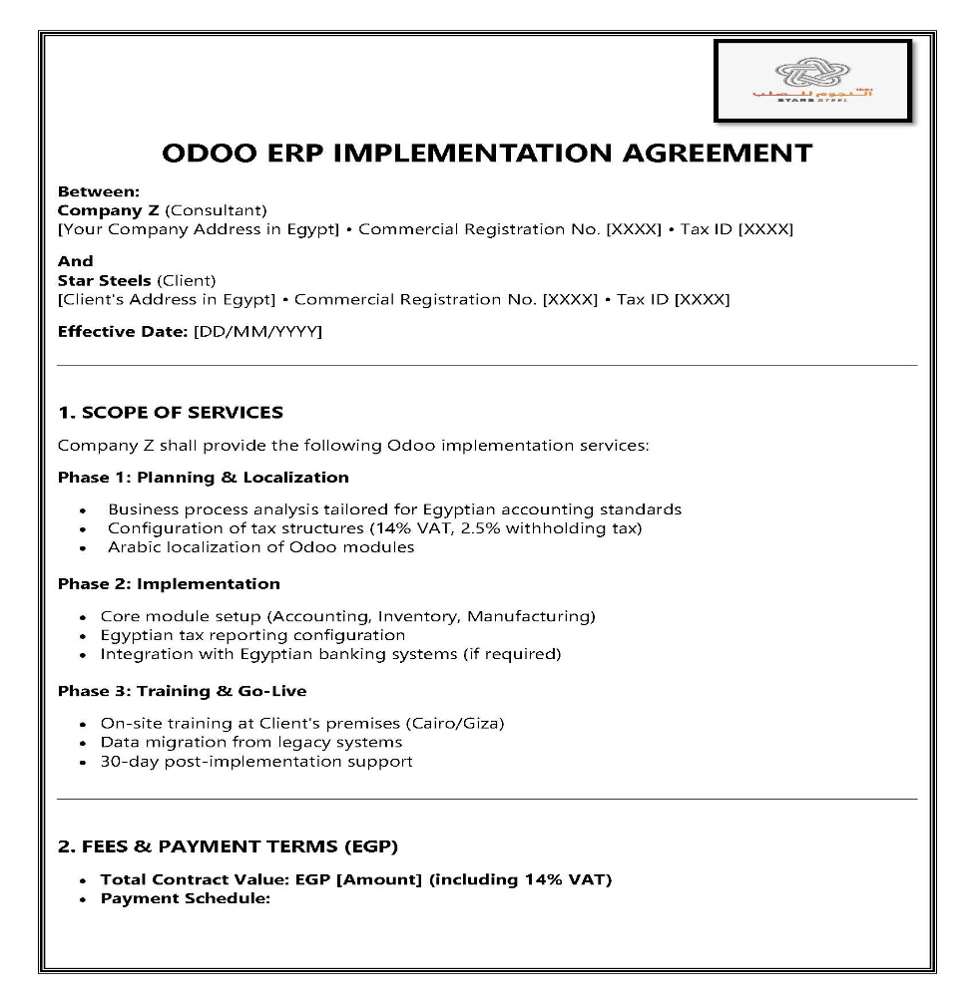
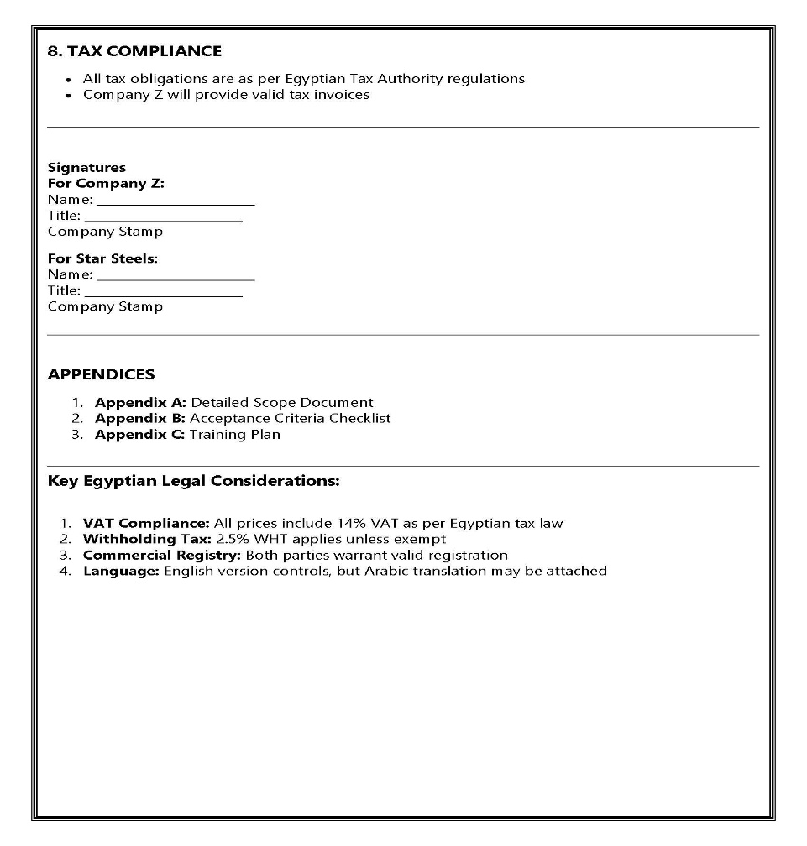
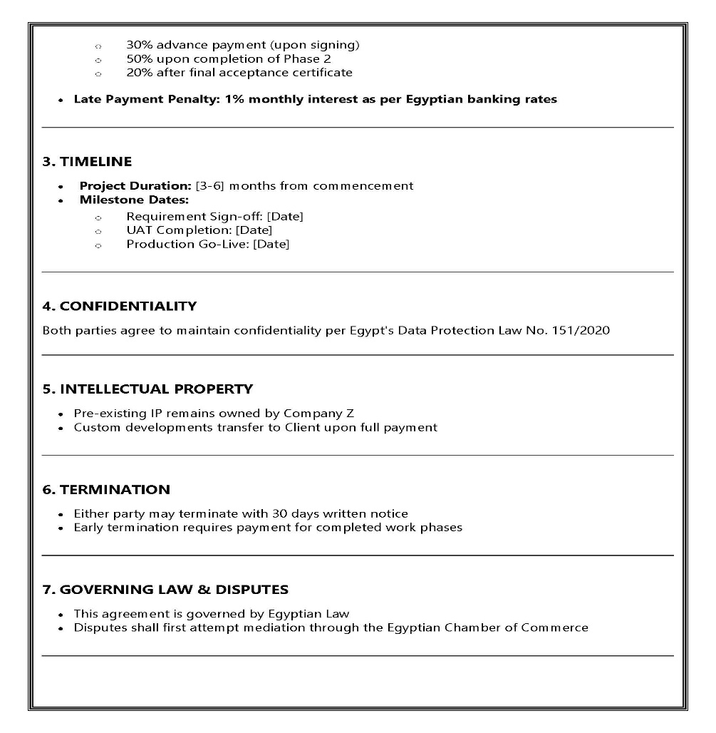
Contract Signed with Star Steels: Our agreement ensures a smooth Odoo implementation, covering scope, timeline, and compliance with Egyptian regulations. and connected to the right accounts in the Chart of Accounts.

Slide 10

Accounting Module By: Nesma Hamed

Slide 11
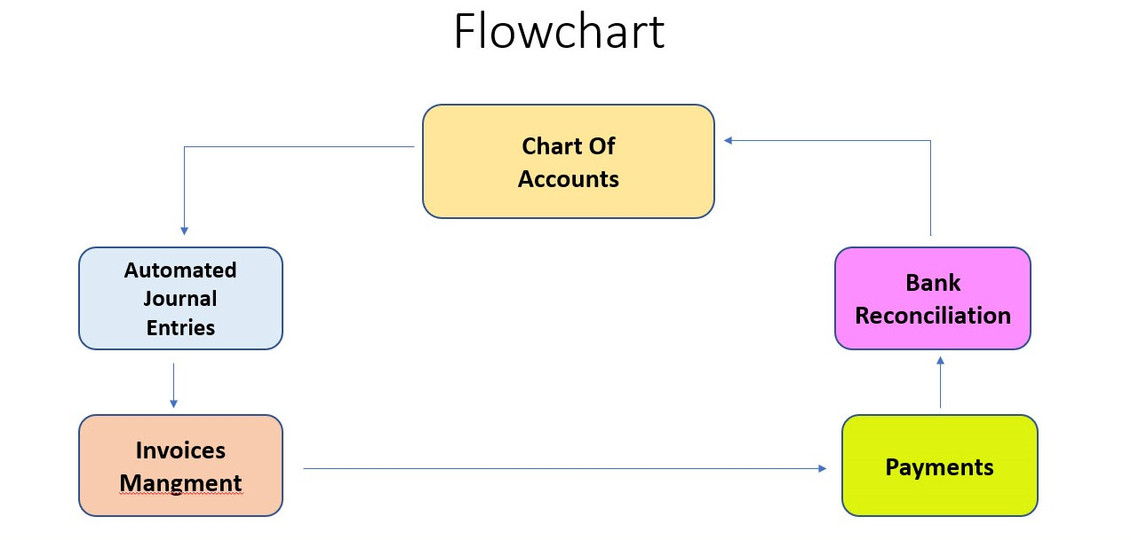
Accounting flowchart

Slide 12
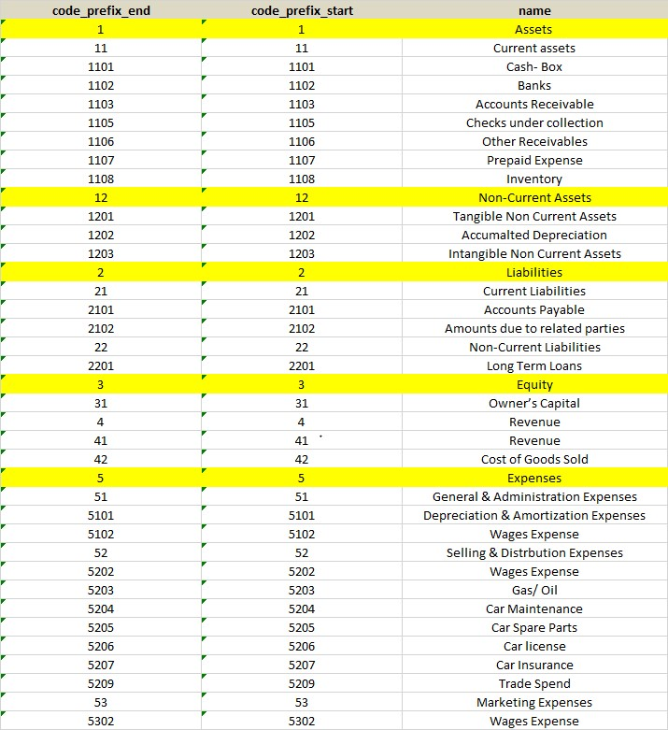
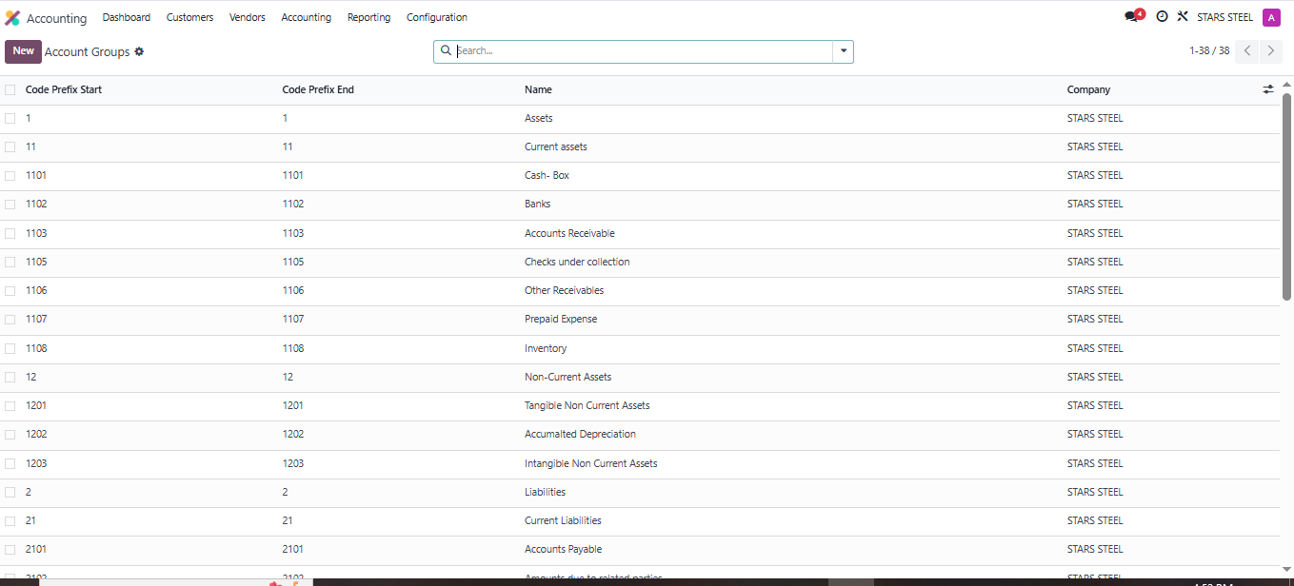
Uploading Account Groups

Slide 13
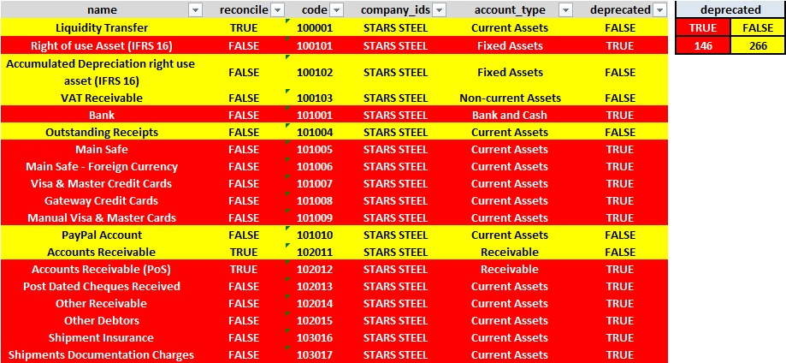
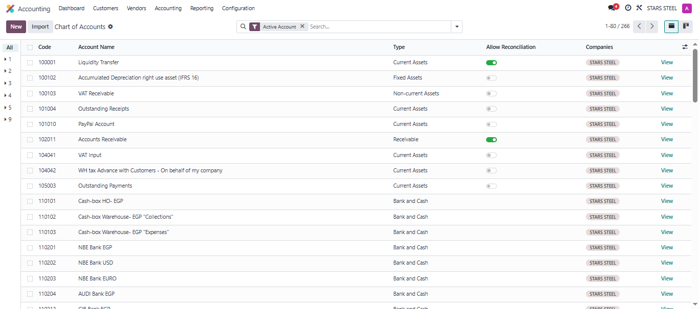
Uploading Chart of Accounts

Slide 14
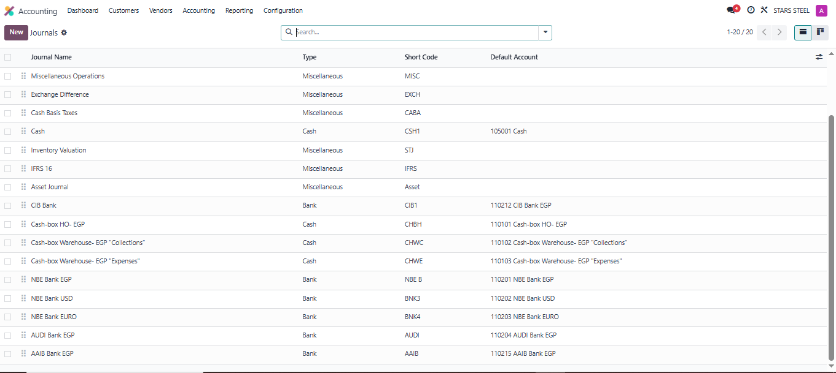
Journals: This image shows how accounting journals are set up in Odoo and connected to the right accounts in the Chart of Accounts.

Slide 15

Inventory Module By: Ahmed Snousy Galal

Slide 16
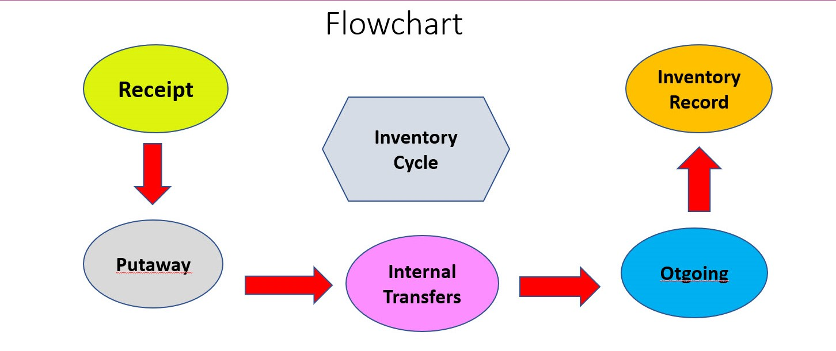
Inventory flowchart

Slide 17
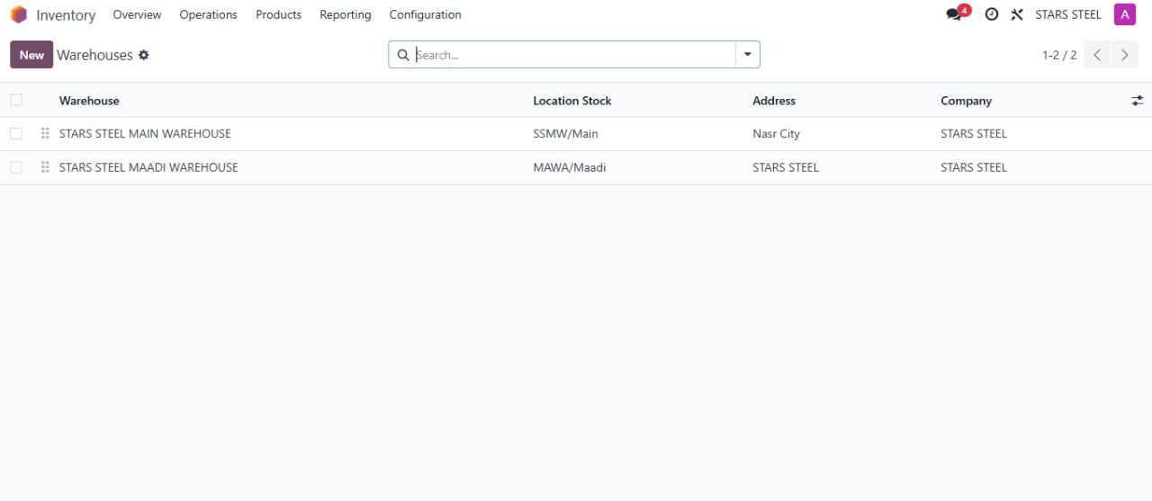
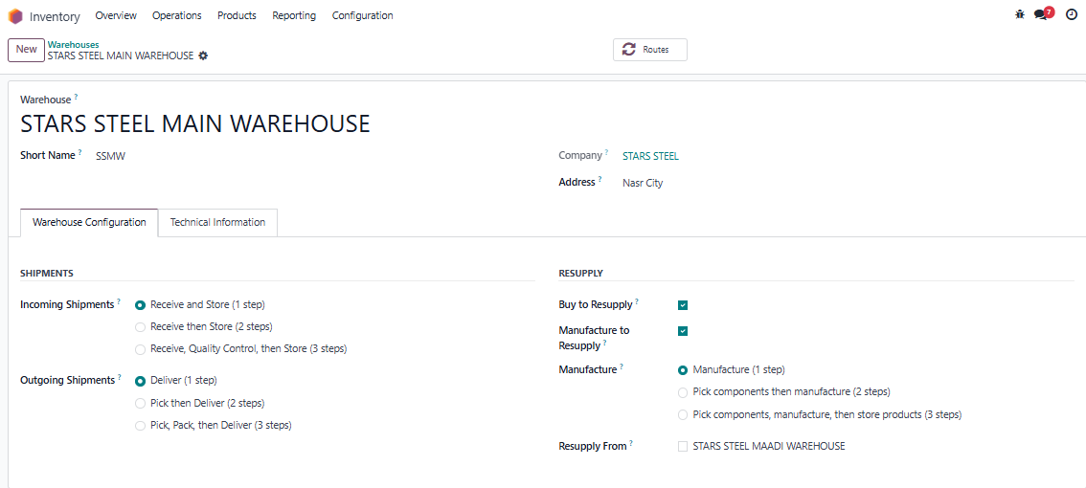
Creating Warehouses

Slide 18
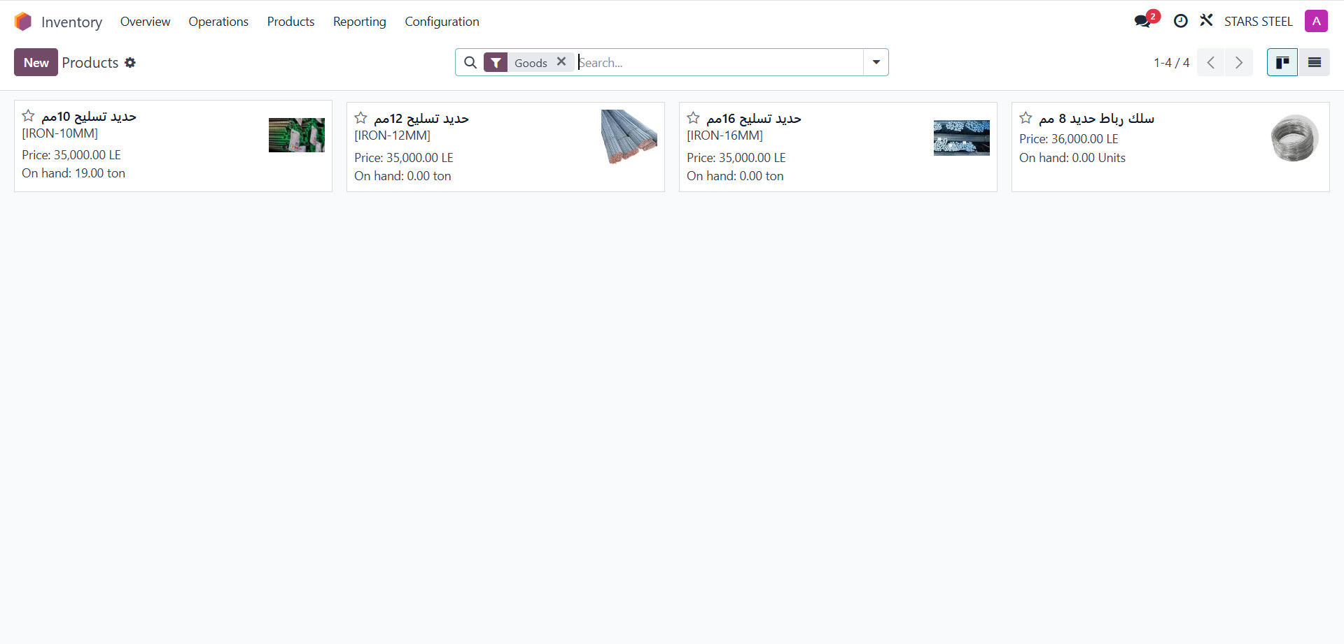
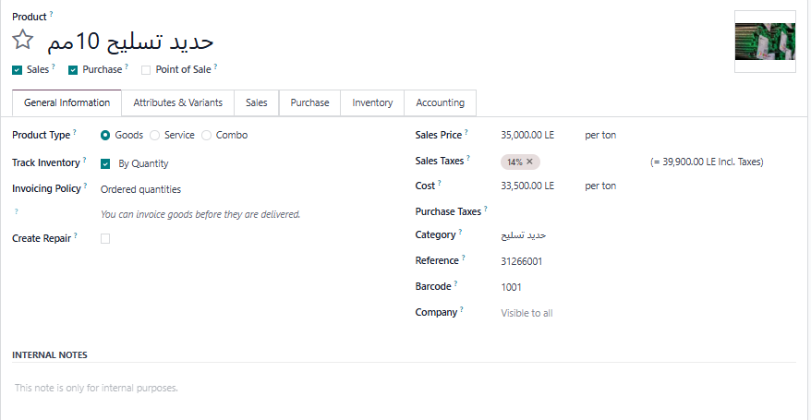
Creating Products

Slide 19
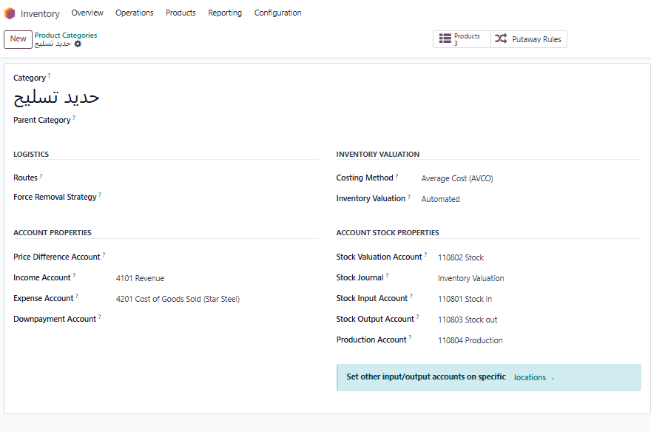
Configuring Product Categories in Odoo Inventory

Slide 20
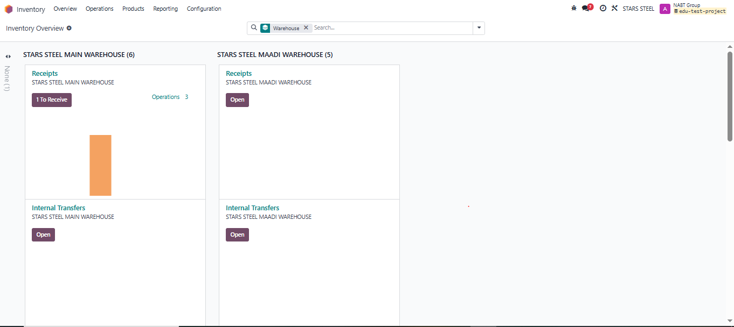
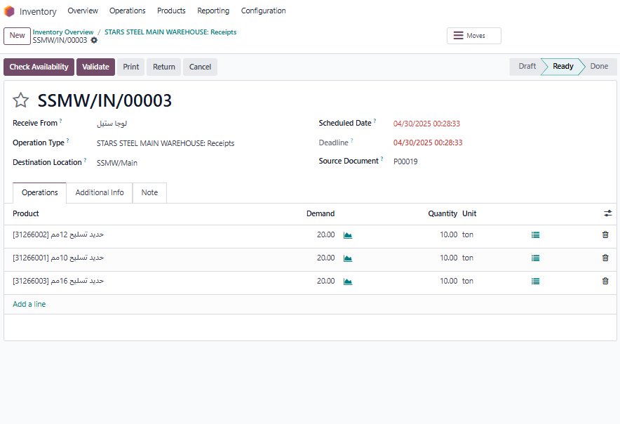
Receiving Products

Slide 21
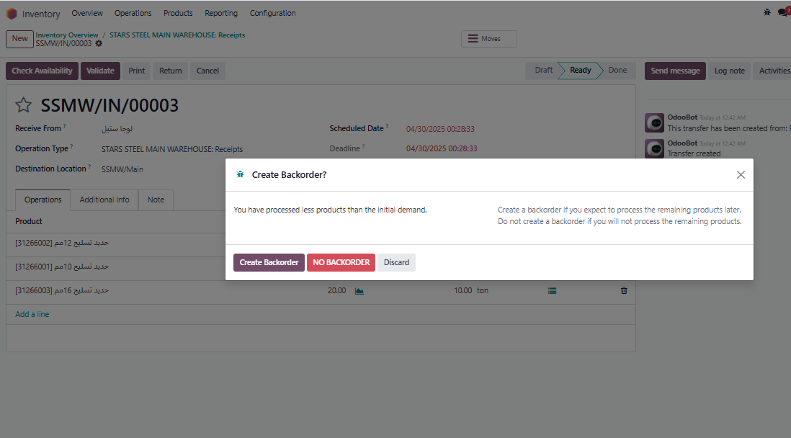
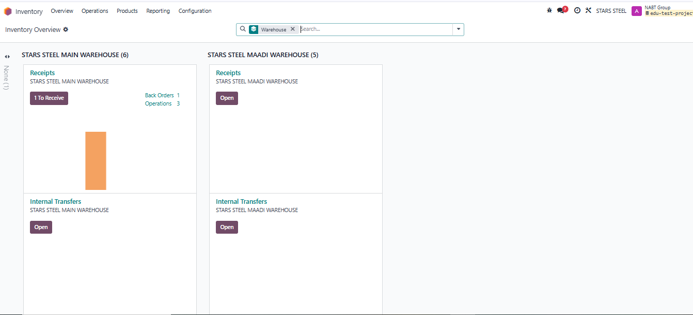
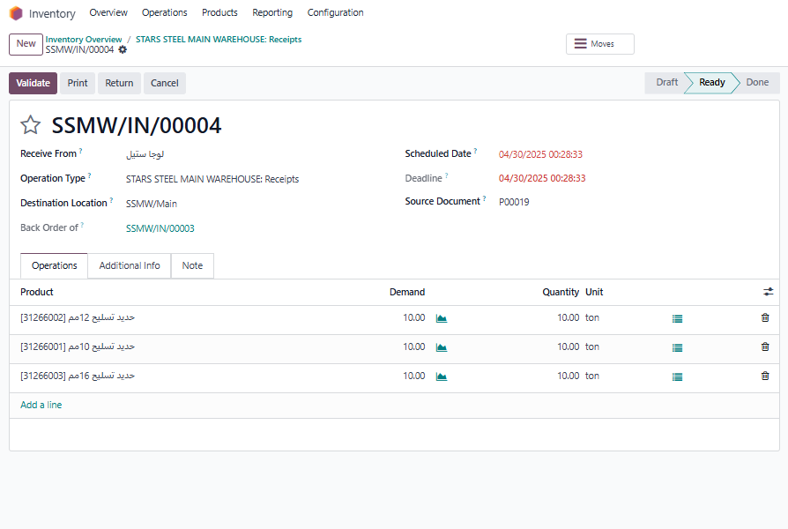
Managing Backorders

Slide 22
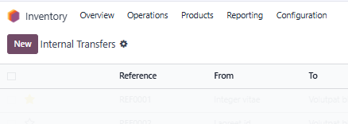
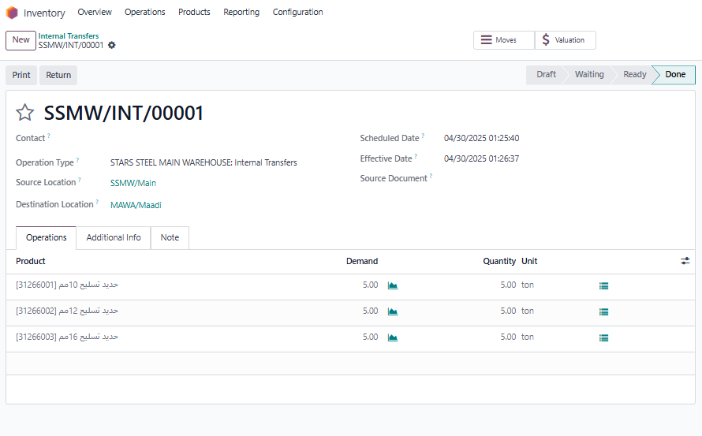
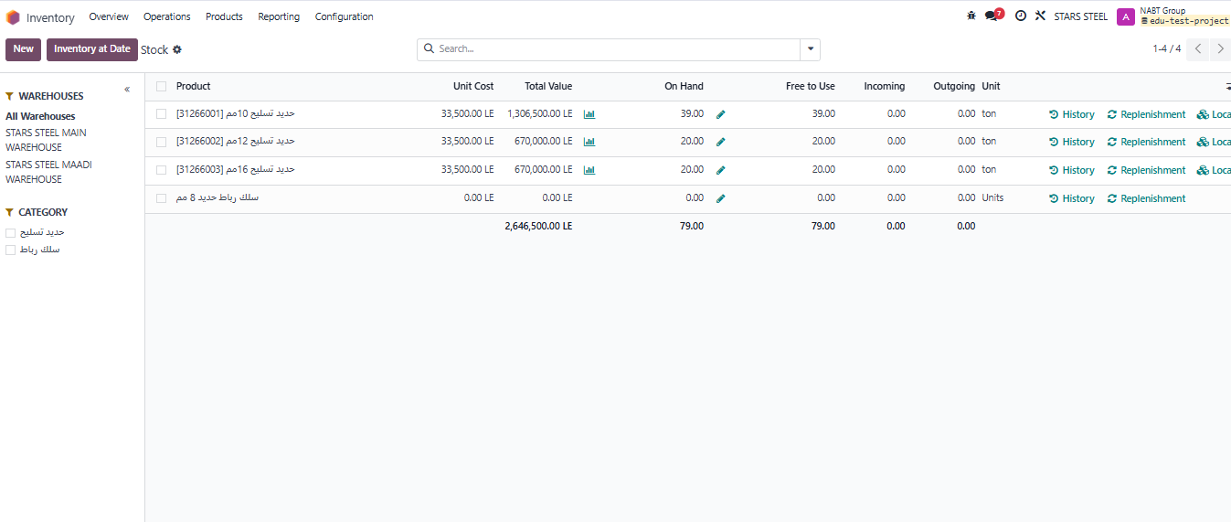
Managing Internal Transfers Between Warehouses
Stock Report

Slide 23
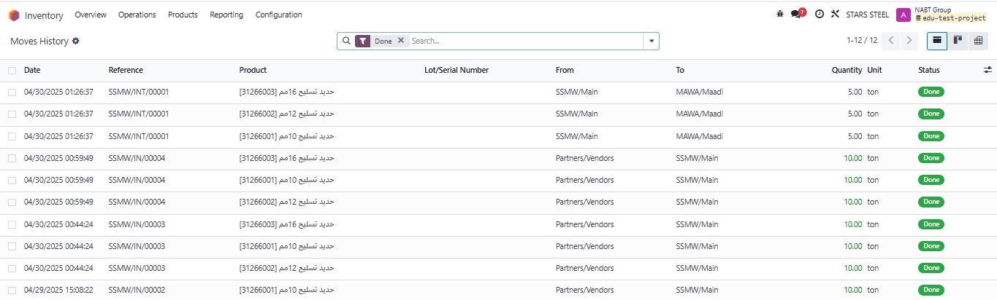
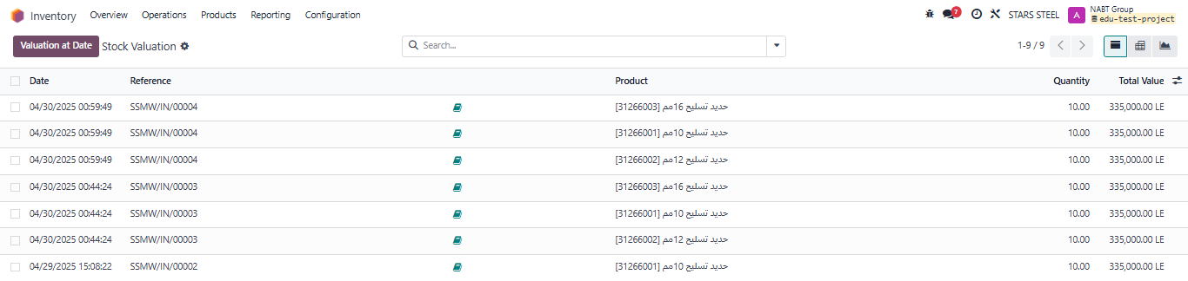
Stock Valuation & Moves History Reports

Slide 24
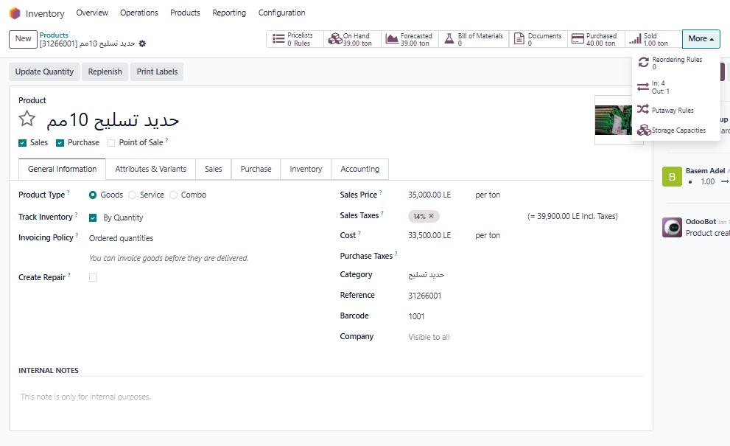
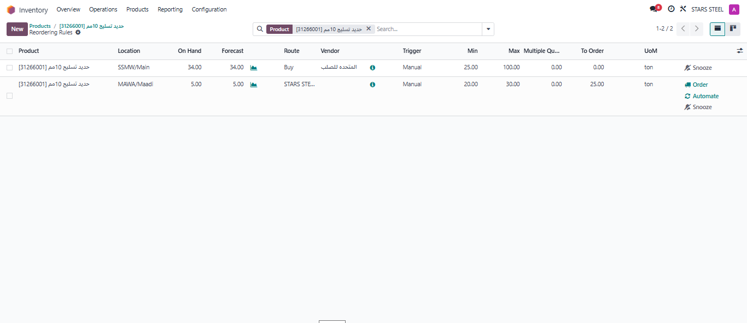
Reordering rules at Odoo Inventory

Slide 25
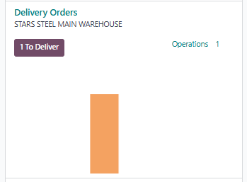
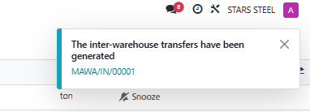
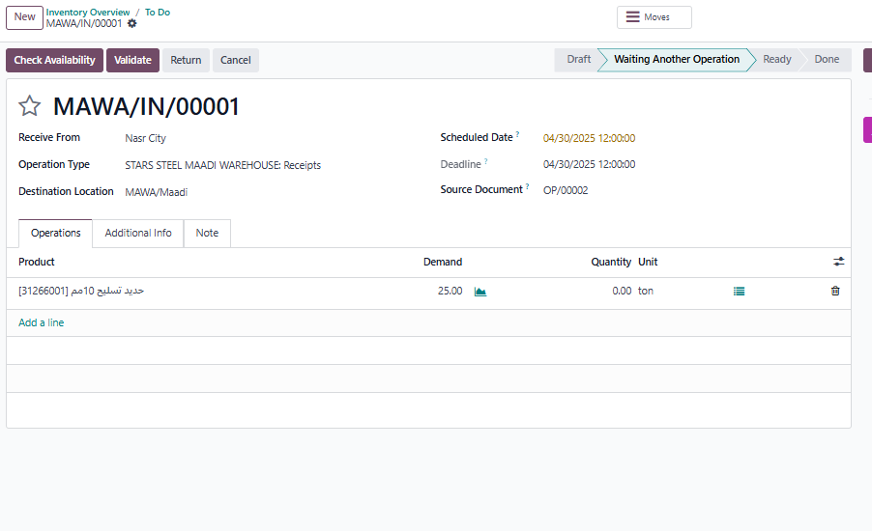
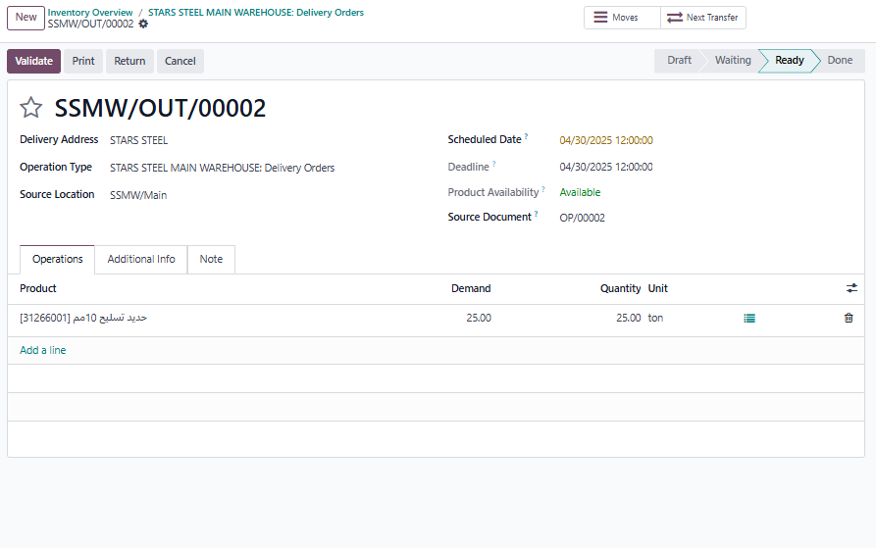
Reordering rules at Odoo Inventory

Slide 26
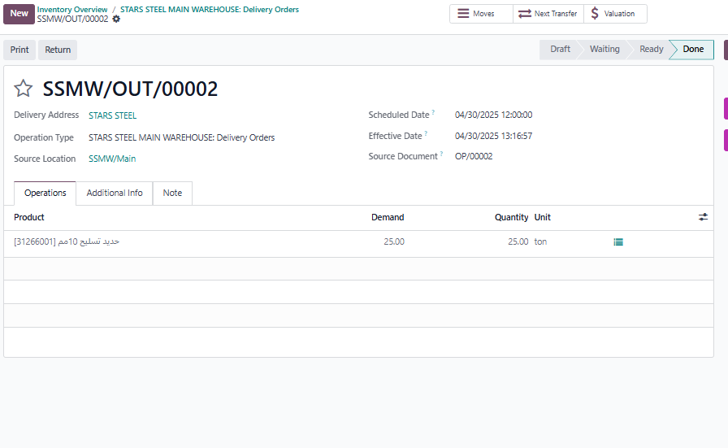
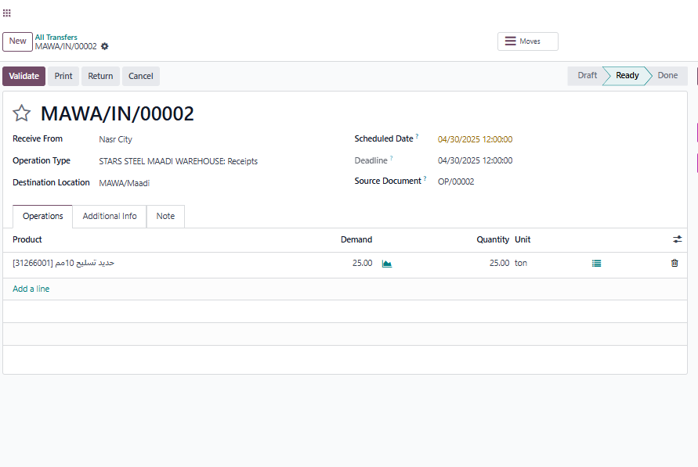
Reordering rules at Odoo Inventory

Slide 27
Reordering rules at Odoo Inventory

Slide 28

Purchase Module By: Tahya Mohamed

Slide 29
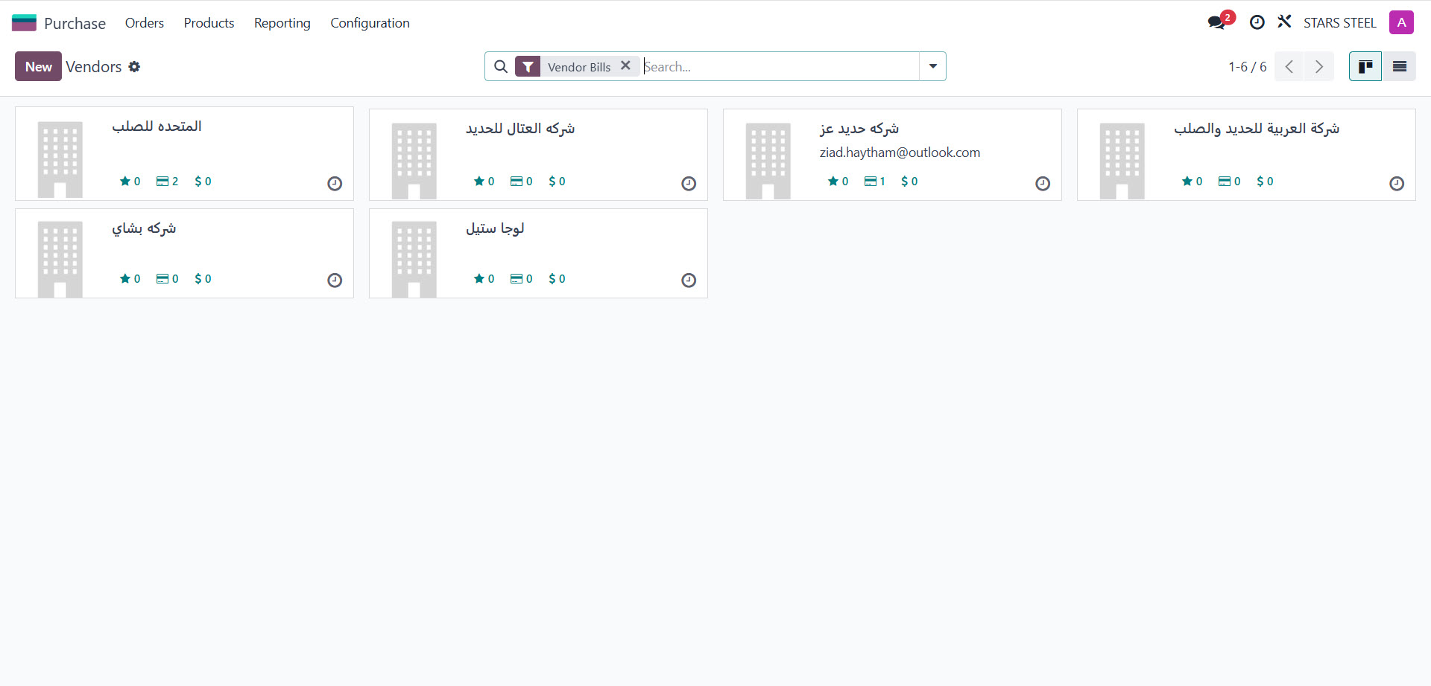
vendors

Slide 30
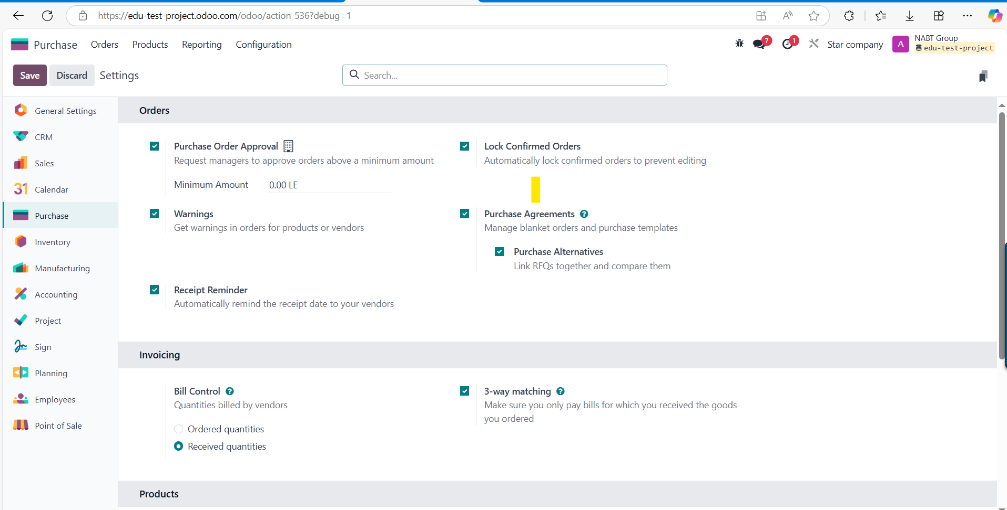
Purchase…config…setting

Slide 31
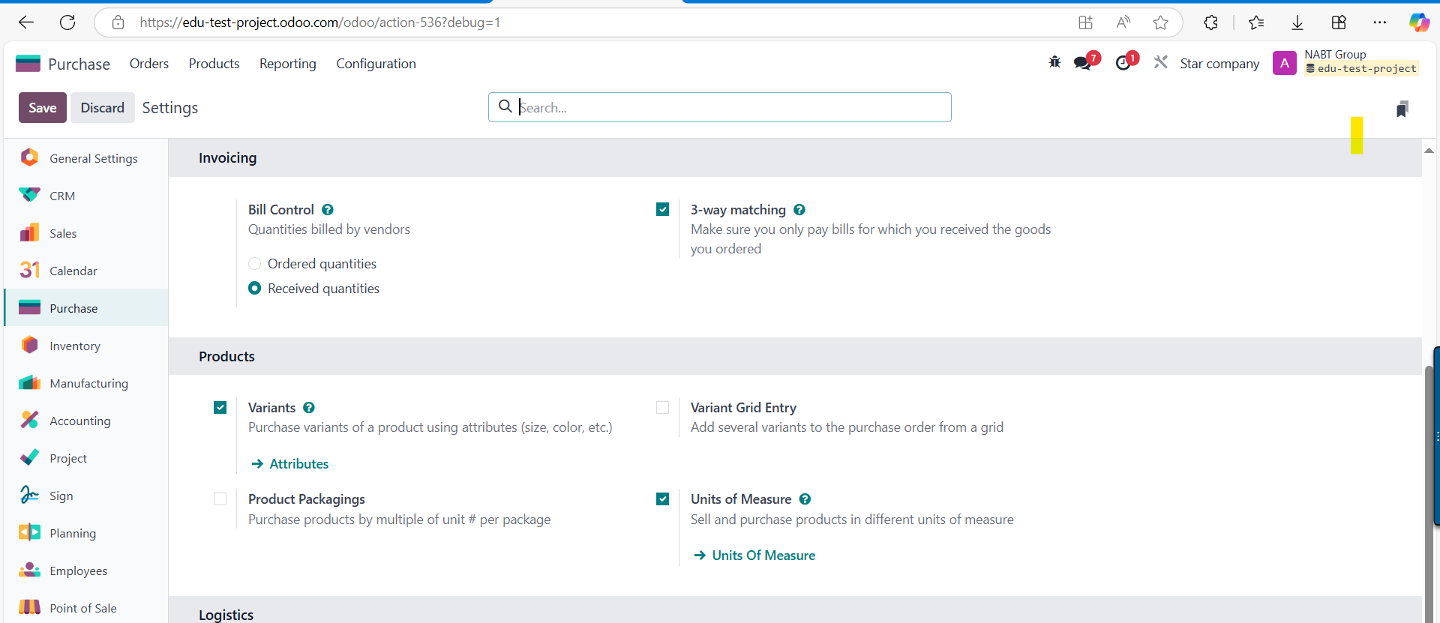
Purchase…config…setting

Slide 32
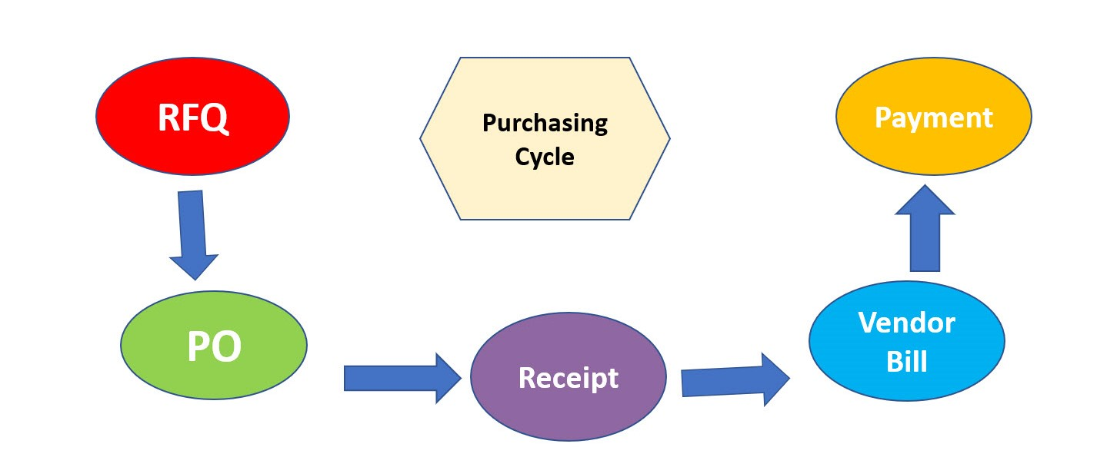
Flowchart

Slide 33
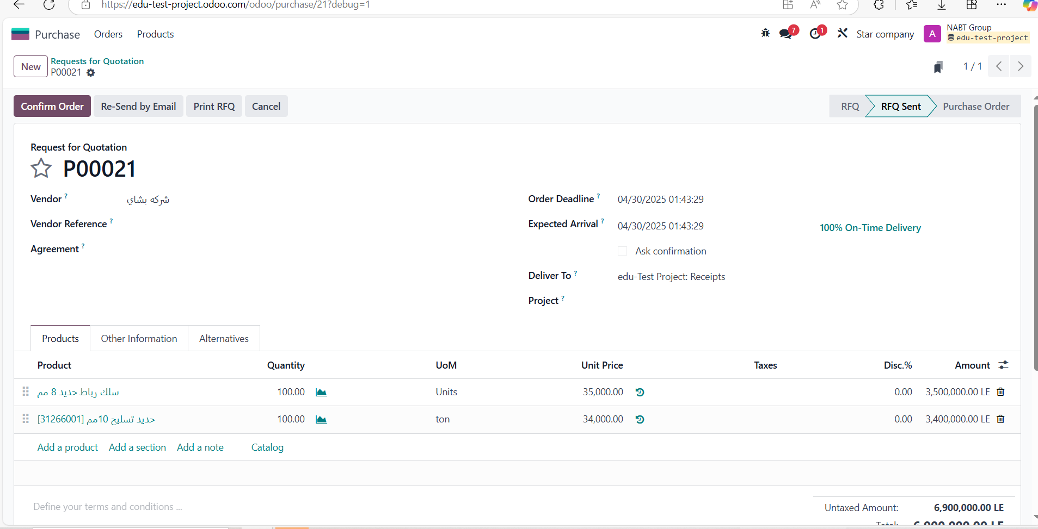
RFQ

Slide 34
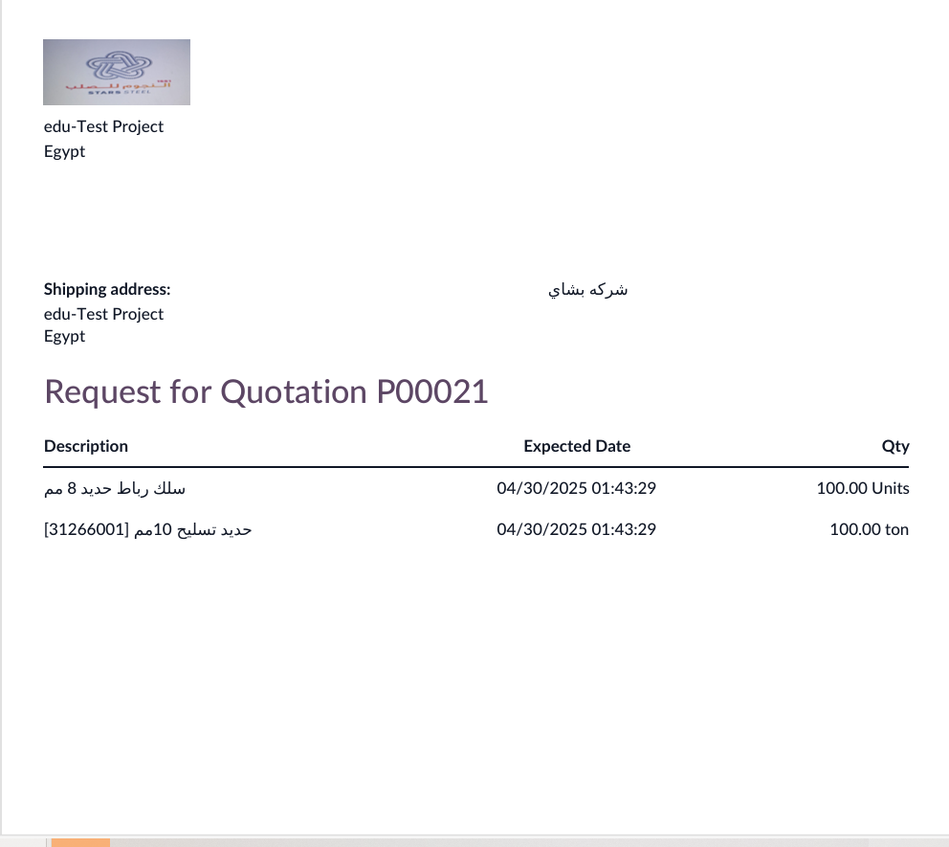
print

Slide 35
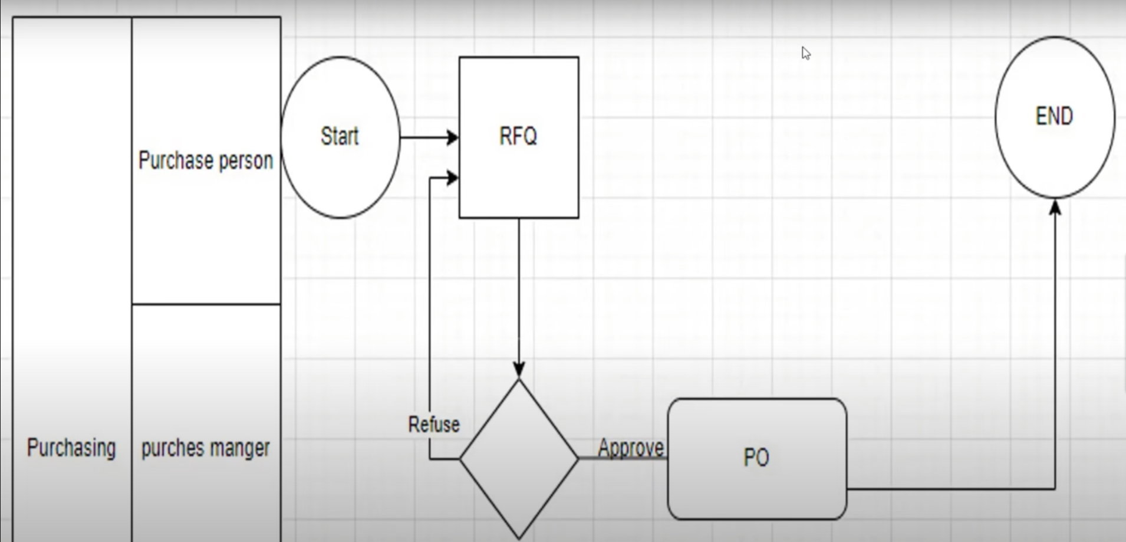
Access right…….approval

Slide 36
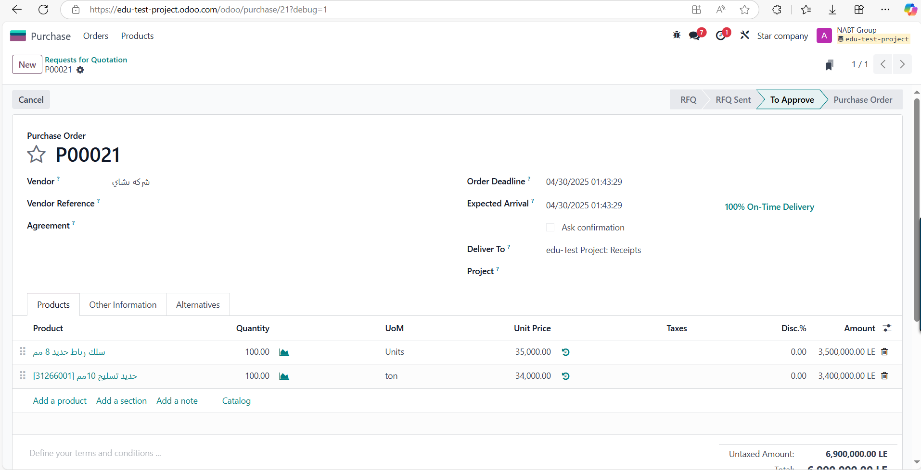
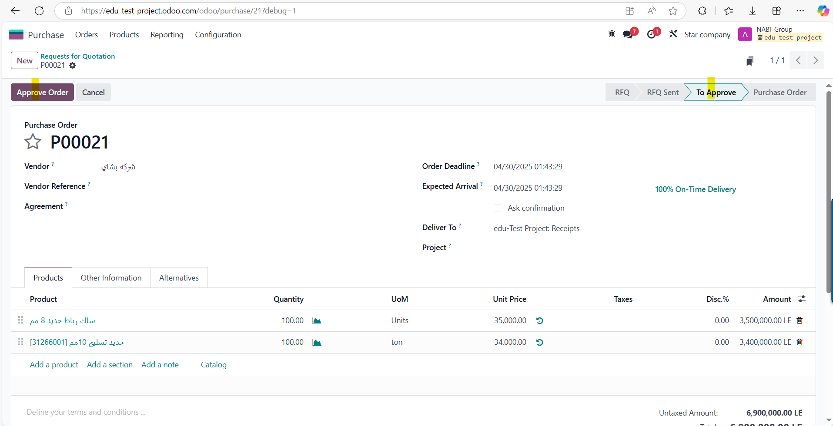
Feature…..approval……purchase person…..manager

Slide 37
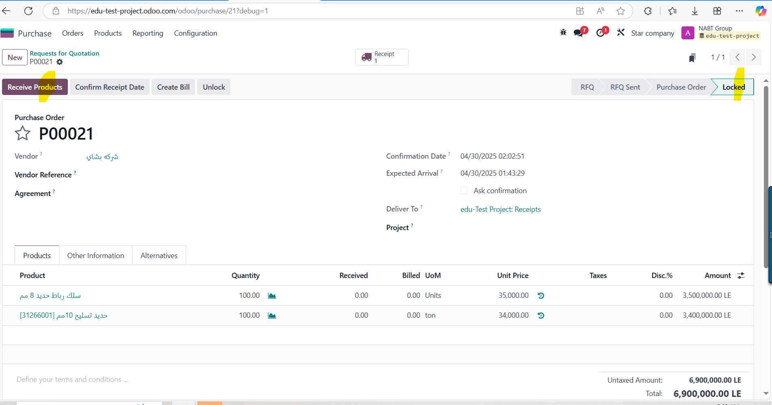
3 ways matches…Po…receive. Bill

Slide 38
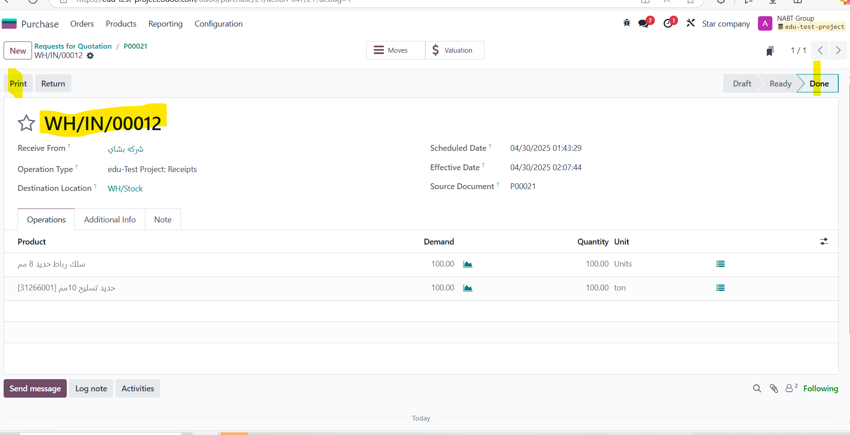
Validate …inventory

Slide 39
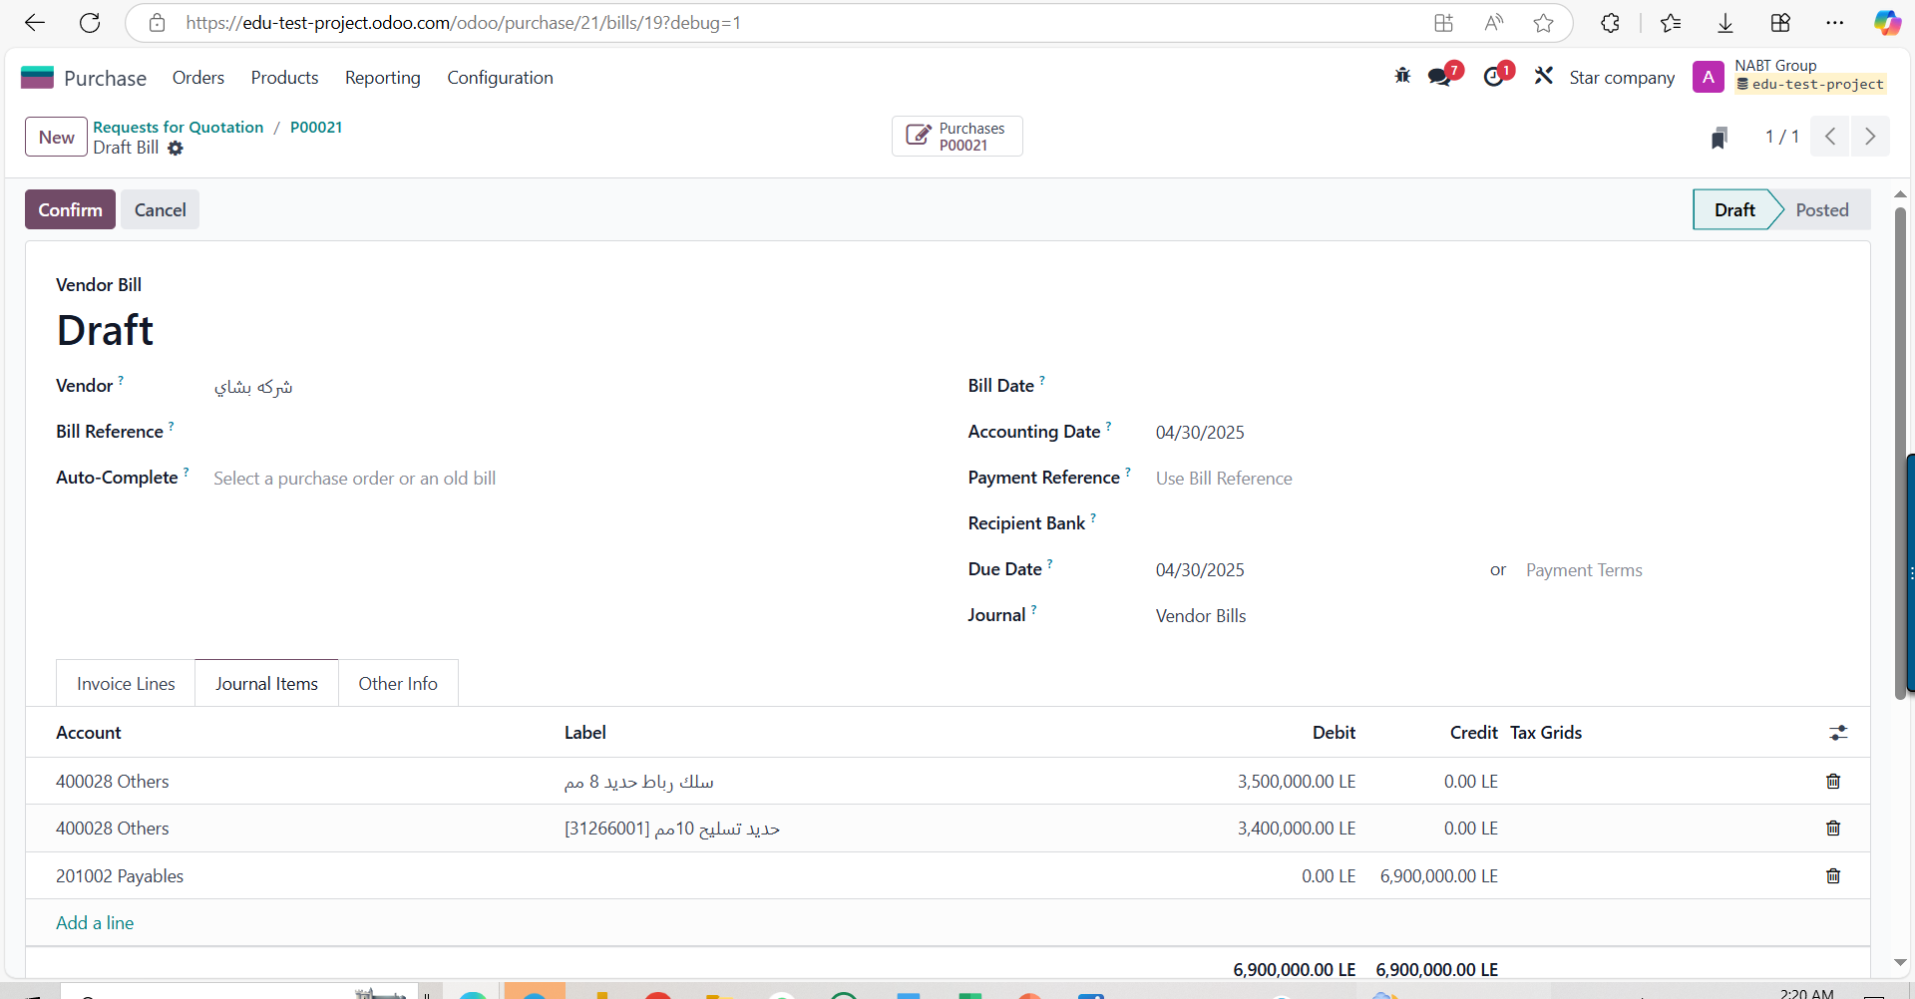
Journals

Slide 40
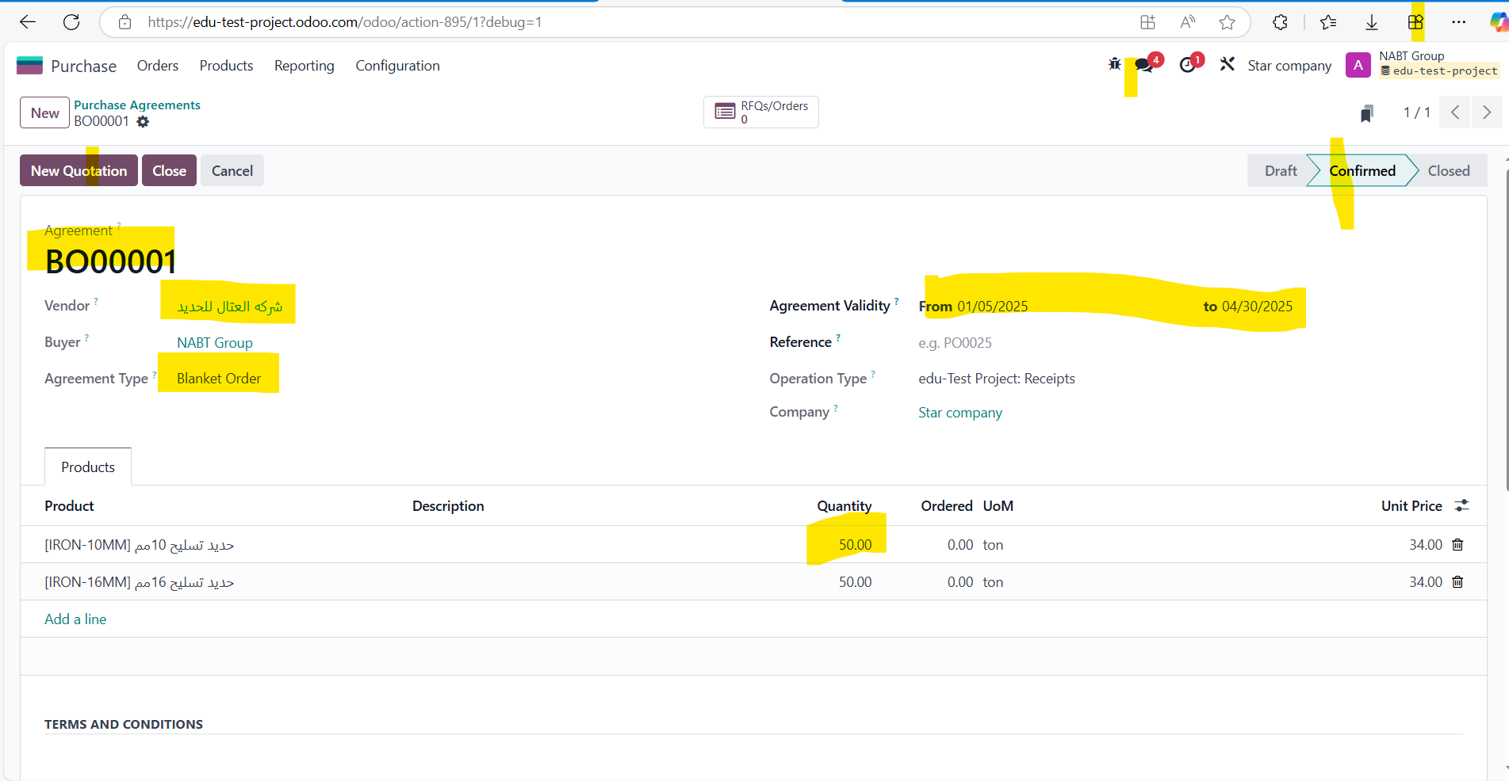
agreement

Slide 41
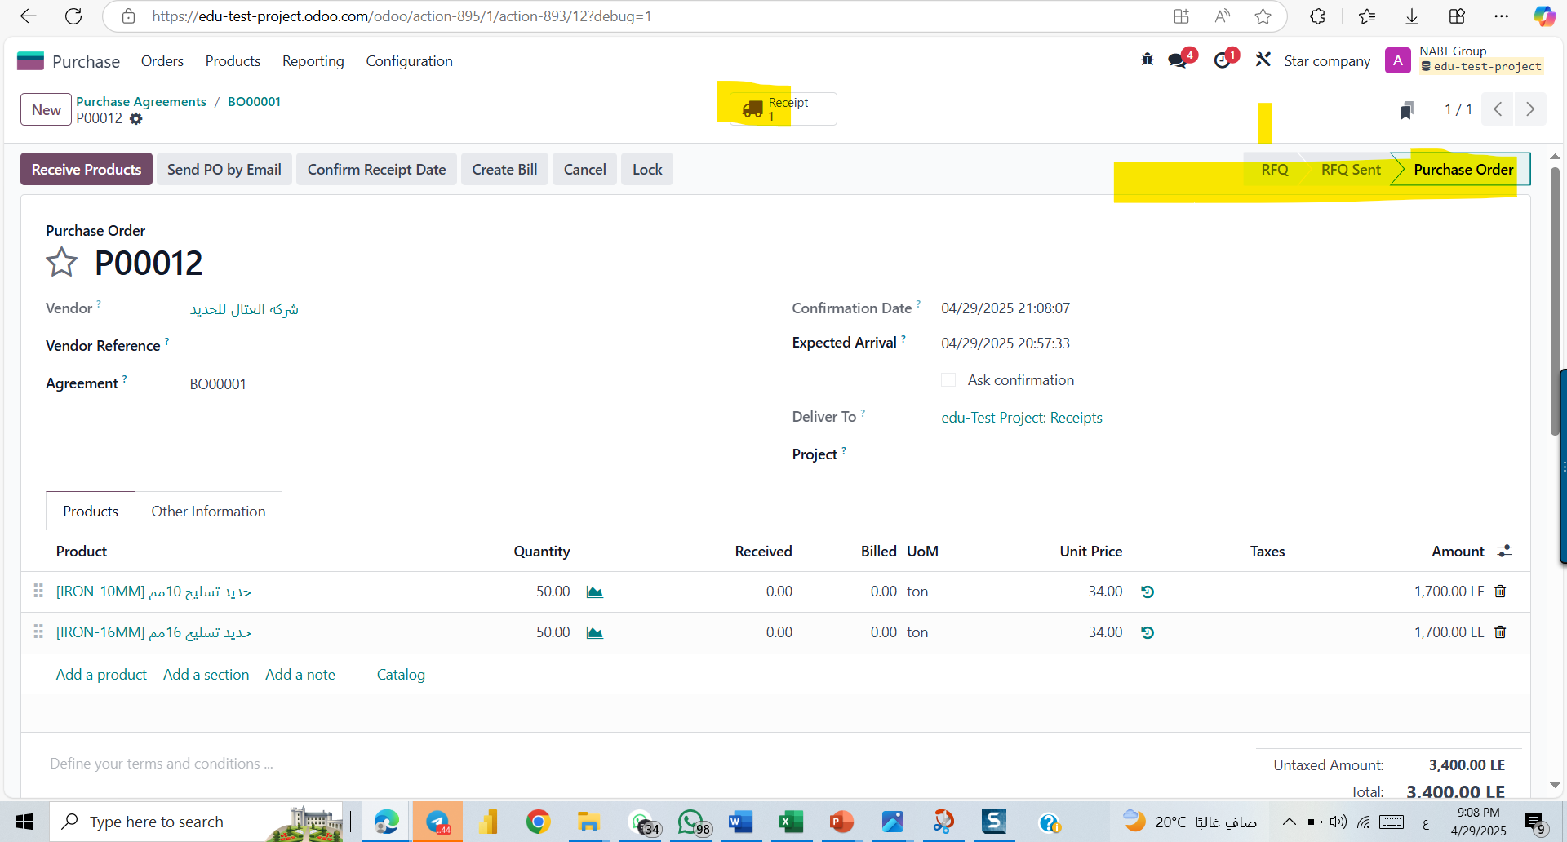
agreement

Slide 42
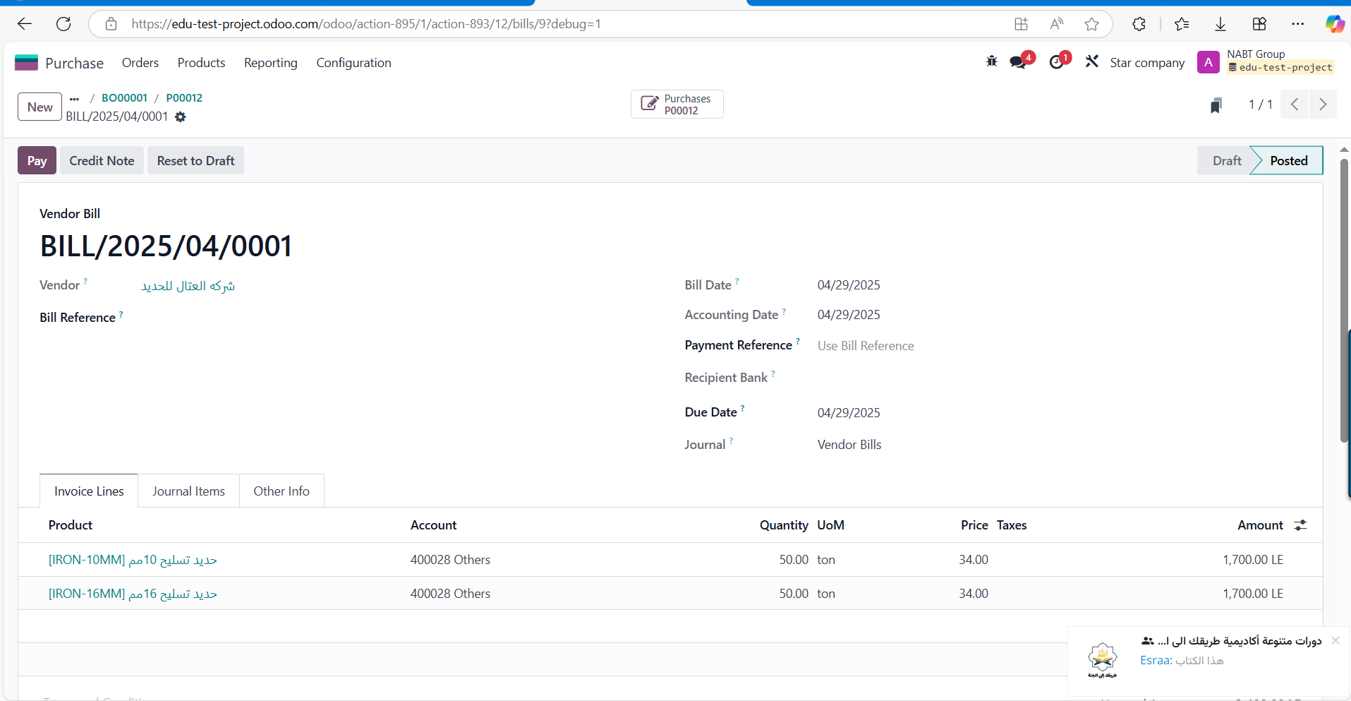
agreement

Slide 43

agreement

Slide 44
agreement

Slide 45

agreement

Slide 46

pricelist

Slide 47

pricelist

Slide 48

pricelist

Slide 49
pricelist

Slide 50

Call for tenders

Slide 51

Call for tenders

Slide 52

Call for tenders

Slide 53

Call for tenders

Slide 54

warning

Slide 55

warning

Slide 56

warning

Slide 57

Sales Module By: Basem Adel

Slide 58

Sales workflow

Slide 59


Customer creation

Slide 60

Quotation

Slide 61

Sales Order and Confirm Sales Order

Slide 62

Delivery Order

Slide 63

Invoice

Slide 64

Confirmation

Slide 65


Payment

Slide 66

Dashboard

Slide 67


Create new user

Slide 68

Setting responsibilities

Slide 69



Delivery methods

Slide 70


Discount

Slide 71


Price list

Slide 72

Price list

Slide 73
Conclusion
We sincerely thank everyone for taking the time to listen to our project discussion. It has been a valuable experience, and we’ve learned a lot. We would also like to express our gratitude to the initiative for giving us this opportunity

